Slide 1
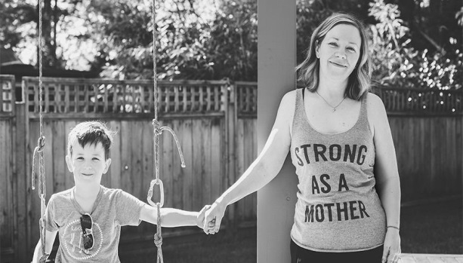
Social Skills & Dining

Slide 2
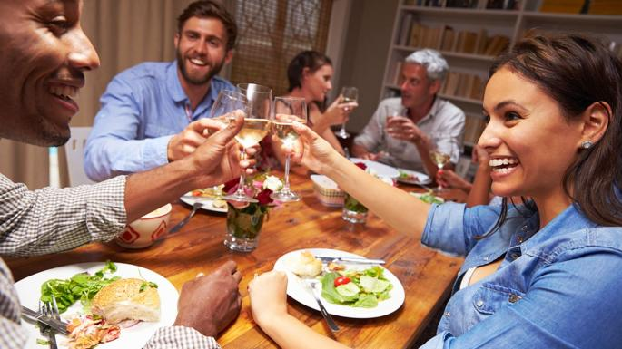
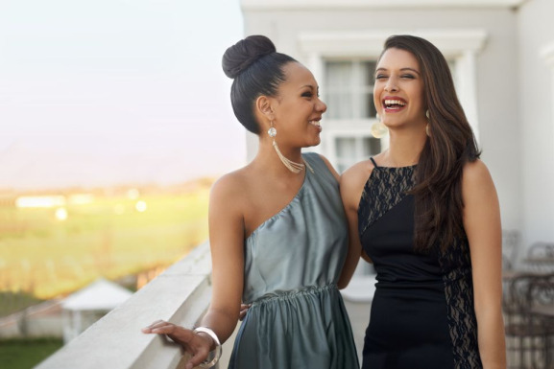
Social Skills
Excellent social skills are an essential accoutrement in moving forward in today’s complex professional environment. These are skills used on a day to day basis in the workplace and all social events.
www.womensderm.org
2

Slide 3
Social Skills
Communication
Current Events
Know your Community
Know your Audience
Interpersonal Skills
Kind
Polite
Courteous

Slide 4
Social Skills
Use appropriate handshakes
Maintain eye contact
Use proper body language
Know the difference between being assertive (good) and being aggressive (bad)
Select appropriate vs. inappropriate topics for conversation
Avoid controversial topics such as politics and religion (unless appropriate for the situation)
Come prepared (research the company, person(s) you are interacting/meeting)
Be prepared to listen, learn, and speak when appropriate
Smile

Slide 5
Social Conversation Starters
The weather
Who are you?
Who am I?
Current events
Hobbies
Physical fitness routines
Travels
DO NOT TALK ABOUT
Your previous employers negatively

Slide 6
Appropriate Attire
Clothing that is always safe:
Minimize the size of your jewelry. Less is always more. Shy away from gaudy pieces.
The little black dress is always safe…but not too little. It should be appropriate for your age and size.
Another rule to consider for makeup and perfume is less is more.

Slide 7
Appropriate Attire for Business Interviews
You are going on an interview for a professional job. Your resume is solid, you’ve researched the company or organization and have pertinent and interesting topics of conversations to discuss.
What do you wear?

Slide 8
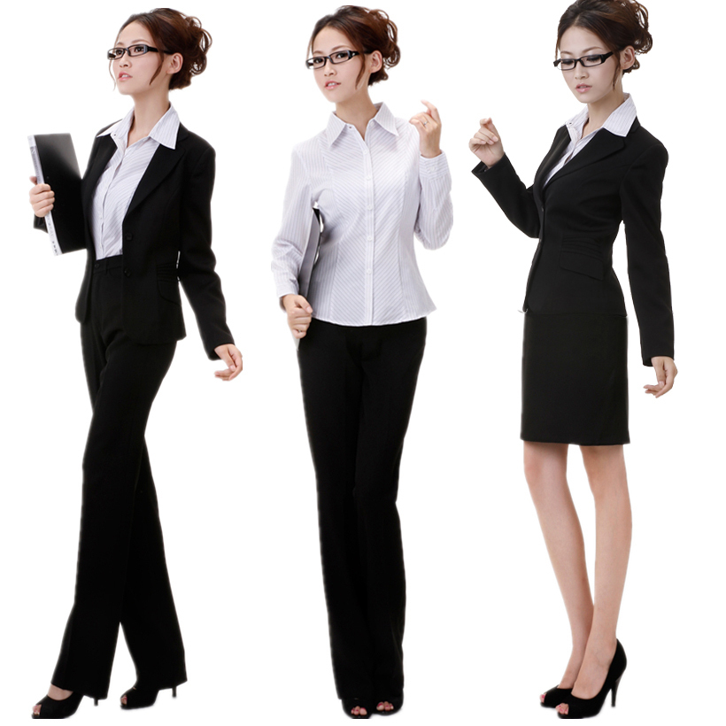
Appropriate Attire for Business Interviews

Slide 9
Appropriate Attire for Dinner
You are excited that you have been invited out to a great, formal dinner and a magnificent evening of fun, wonderful food, and entertainment.
What should you wear?

Slide 10
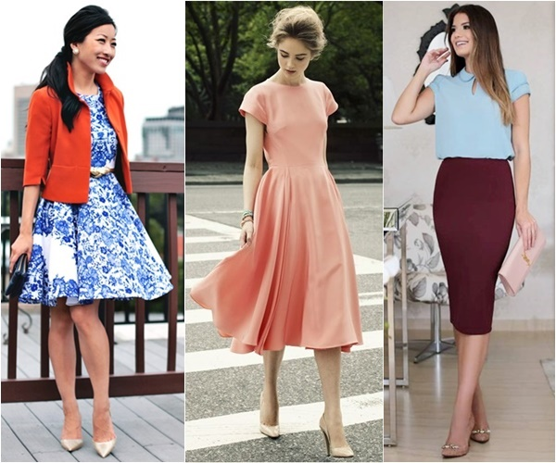
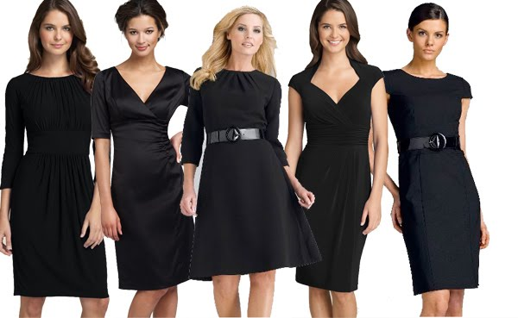
Appropriate Attire for Dinner

Slide 11
Dining Etiquette 101
You are dressed to impress. You are all set –until you realize that the interview includes a formal meal.
Are you really ready?

Slide 12
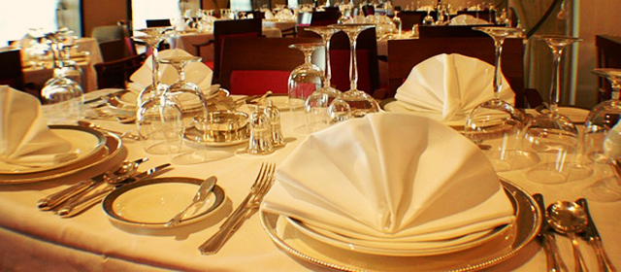
Table Setting

Slide 13
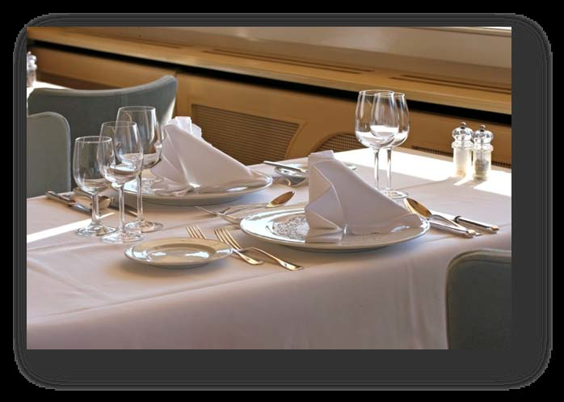
Dining Etiquette 101
Out in the real world some of the most important interviews and meetings take place over a meal. This meal isn't a burger and fries, pizza with friends, or a quick bite at the dining hall. This meal is at a restaurant with linen table clothes, several forks and spoons, and small butter pats molded into shapes. Do you know what to do?

Slide 14
Top 10 Table Manners
Before the Meal
Place your napkin on your lap.
Keep personal items (including smart phones) off the table.
During the Meal
Wait until all guests are served and the host begins eating before you begin eating.
Understand the table setting – use the “outside-in” rule.
Hold your utensils appropriately.
Chew with your mouth closed.
Always pass the salt and pepper together.
If an item is not being passed to a specific person, pass food from left to right.
After the Meal
When finished eating, position your silverware to tell the server you are done.
Fold your used napkin and place it to the left of your place setting.

Slide 15
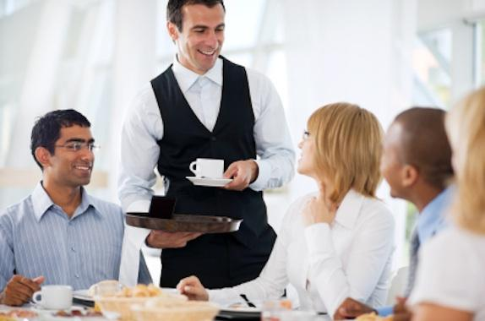
Dining Etiquette 101
Table manners play an extremely important part in making a favorable impression. They are visible indicators of our manners and essential to professional success. Whether it’s a lunch with a prospective employer or dinner with a business associate, your table manners speak volumes about you as a professional.

Slide 16
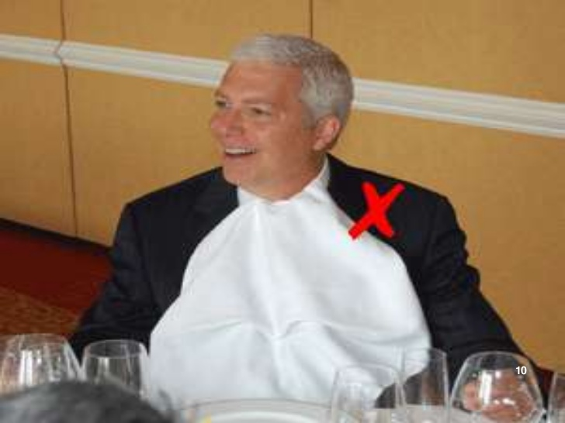
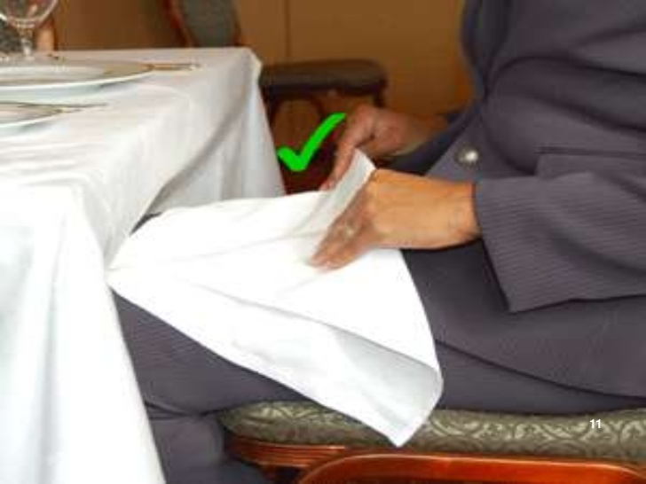
Napkin Use
The meal begins when the host unfolds his or her napkin. This is your signal to do the same. Place your napkin on your lap, completely unfolded if it is a small luncheon napkin or in half, lengthwise, if it is a large dinner napkin. Typically, you want to put your napkin on your lap soon after sitting down at the table (but follow your host's lead). The napkin remains on your lap throughout the entire meal and should be used to gently blot your mouth when needed. If you need to leave the table during the meal, place your napkin on your chair as a signal to your server that you will be returning. The host will signal the end of the meal by placing his or her napkin on the table. Once the meal is over, you too should place your napkin neatly on the table to the right of your dinner plate. (Do not refold your napkin, but don't wad it up, either.)

Slide 17
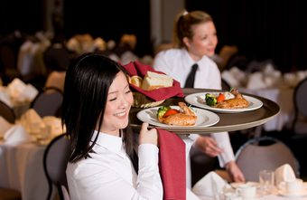
Ordering
If, after looking over the menu, there are items you are uncertain about, ask your server any questions you may have. Answering your questions is part of the server's job. It is better to find out before you order that a dish is prepared with something you do not like or are allergic to than to spend the entire meal picking tentatively at your food.

Slide 18
Ordering
An employer will generally suggest that your order be taken first; his or her order will be taken last. Sometimes, however, the server will decide how the ordering will proceed. Often, women's orders are taken before men’s. As a guest, you should not order one of the most expensive items on the menu or more than two courses unless your host indicates that it is all right. If the host says, “I'm going to try this delicious sounding cheesecake; why don't you try dessert too,” or “The prime rib is the specialty here; I think you'd enjoy it,” then it is all right to order that item if you would like. Order familiar foods that you know you like.

Slide 19
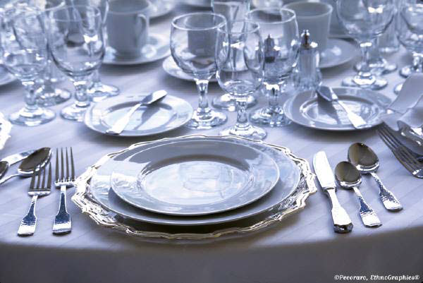
Reading the Table Setting
At a formal dinner, it’s possible to gain clues about what may be served by “reading” the place setting. Draw an imaginary line down the center of your plate. To the right, will be glassware, cup and saucer, knives, and spoons, as well as a seafood fork if the meal includes seafood. It is important to place the glassware or cup back in the same position after its use in order to maintain the visual presence of the table. To the left will be the bread and butter plate, salad plate, napkin, and forks.

Slide 20
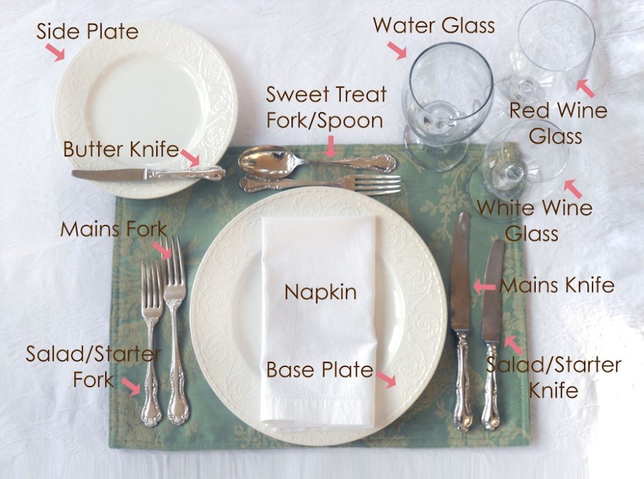
Reading the Table Setting

Slide 21
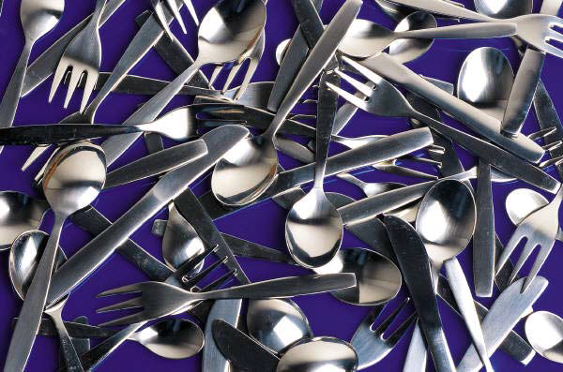
Use of Silverware
Choosing the correct silverware from the variety in front of you is not as difficult as it may first appear. Starting with the knife, fork, or spoon that is farthest from your plate, work your way in, using one utensil for each course. The salad fork is on your outermost left, followed by your dinner fork. Your soupspoon is on your outermost right, followed by your beverage spoon, salad knife and dinner knife. Your dessert spoon and fork are above your plate or brought out with dessert. If you remember the rule to work from the outside in, you'll be fine.

Slide 22
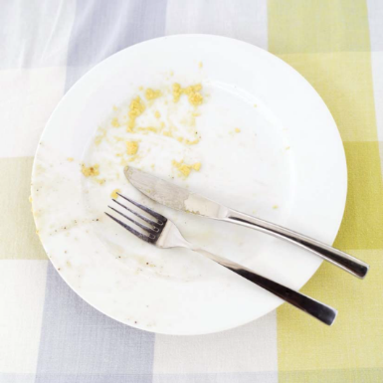
When You are Finished…
Do not push your plate away from you when you have finished eating. Leave your plate where it is in the place setting. The common way to show that you have finished your meal is to lay your fork and knife diagonally across your plate. Make sure they are placed in such a way that they do not slide off the plate as it is being removed. Once you have used a piece of silverware, never place it back on the table. Do not leave a used spoon in a cup, either; place it on the saucer. You can leave a soupspoon in a soup plate. Any unused silverware is simply left on the table.

Slide 23
Basic Table Etiquette
It is inappropriate to ask for a doggy bag when you are a guest.
It is best to order foods that can be eaten with a knife and fork.
Do not order alcoholic beverages —even if everyone else does
Sit up straight at the table. It makes a good impression.
When you are not eating, keep your hands on your lap or resting on the table (with wrists on the edge of the table).
Elbows on the table are acceptable only between courses, not while you are eating.
Do not season your food before you have tasted it.
Never chew with your mouth open or make loud noises when you eat. Although it is possible to talk with a small piece of food in your mouth, do not talk with your mouth full.

Slide 24
Basic Table Etiquette
Do not slurp soup from a spoon. Spoon the soup away from you when you take it out of the bowl and sip it from the side of the spoon. If your soup is too hot to eat, let it sit until it cools; do not blow on it. Better yet, don’t order soup.
If food gets caught between your teeth and you can't remove it with your tongue, leave the table and go to a mirror where you can remove the food from your teeth in private.
Eat rolls or bread by tearing off small bite size pieces and buttering only the piece you are preparing to eat. When ready for another piece, repeat the same process.
Table conversation should be pleasant but entirely free of controversial subjects. Do not ask someone a question as they are about to take a bite.

Slide 25
Basic Table Etiquette
If you need something that you cannot reach easily, politely ask the person closest to the item you need to pass it to you. “After you have used them yourself, would you please pass me the salt and pepper?”
If a piece of your silverware falls onto the floor, pick it up if you can reach it and let the server know you need a clean one. If you cannot reach it, tell the server you dropped a piece of your silverware and ask for a clean one.
If you or someone you are dining with is left-handed, it is best for the left-handed person to sit at the left end of the table or at the head of the table. This arrangement helps ensure that everyone has adequate elbow room to eat comfortably.
If food spills off your plate, you may pick it up with a piece of your silverware and place it on the edge of your plate.

Slide 26
Basic Table Etiquette
Never spit a piece of bad food or tough gristle into your napkin. Remove the food from your mouth using the same utensil it went in with. Place the piece of food on the edge of your plate. If possible, cover it with some other food from your plate.
Under no circumstance should you blow your nose into your napkin. If you do need to blow you nose, excuse yourself and go to the restroom.
Do not eat food from someone else’s plate. If someone insists of offering you a taste of their meal, pass them your bread plate for a small sample.
Do not arrive at a business luncheon famished. Do not eat enormous amounts of food as though you have not eaten in days.

Slide 27
Basic Table Etiquette
If you see someone you know in the restaurant at another table, you may acknowledge their presence, but you should not leave your table to socialize with them. Keep your focus on your host.
Turn your cell phone OFF, and put them out of sight.
Never apply or reapply makeup at the table.
A business luncheon, like any other interview, should be followed up with a written thank you note to the host of the meal, as well as any other key attendees.

Slide 28
Social Skills
The basic social and etiquette skills that we have reviewed will help you gracefully navigate any social encounter.
Be yourself with poise, dignity, and confidence.
www.womensderm.org
28

